Slide 1

RASD
Sara Pidò 894744
Chiara Plizzari 893901
Giuseppe Severino 898458

Slide 2
What are the goals of the system? (1)
[G1] A user should be able to go to a meeting.
[G2] A user should be able to know if he/she cannot arrive on time to a
meeting.
[G3] A user should be able to have a break that has a minimum duration
between two meetings.
[G4] The time or the location of a meeting can be modified.
[G5] A user should be able to unsay a meeting.
[G6] A user should be able to have some preferences for the trip.
[G6.1] A user should be able not to use some travel means.
[G6.2] A user should be able not to walk more than a specific distance.
[G6.3] A user should be able to minimize carbon footprint when he/she goes to a meeting.

Slide 3
What are the goals of the system? (2)
[G7] A user should be able to know every possible option to go to a meeting with different travel means in order to choose the suitable one.
[G8] A user should be able to buy public transportation tickets or day/week/season pass basing on his/her needs.
[G9] A user would like to see on Tripadvisor advised places for his/her breaks.
[G10] A user would like to locate the nearest vehicle of a vehicle sharing system if he/she wants to use that type of travel means.
[G11] A user would like to have real-time news on strikes, weather and traffic.

Slide 4
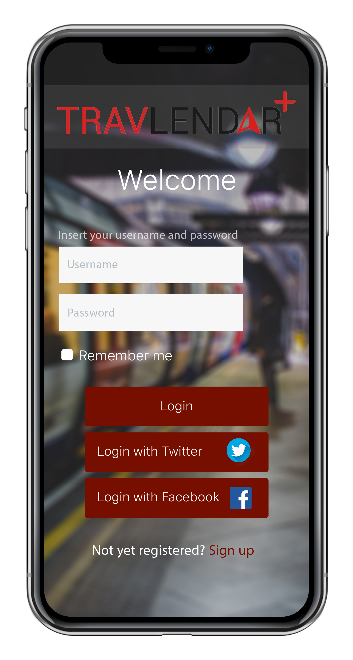
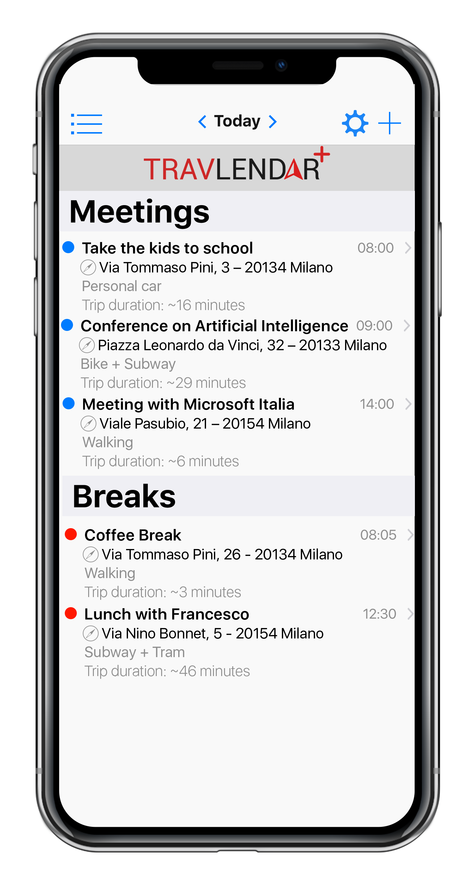
Some Mockups (1)

Slide 5
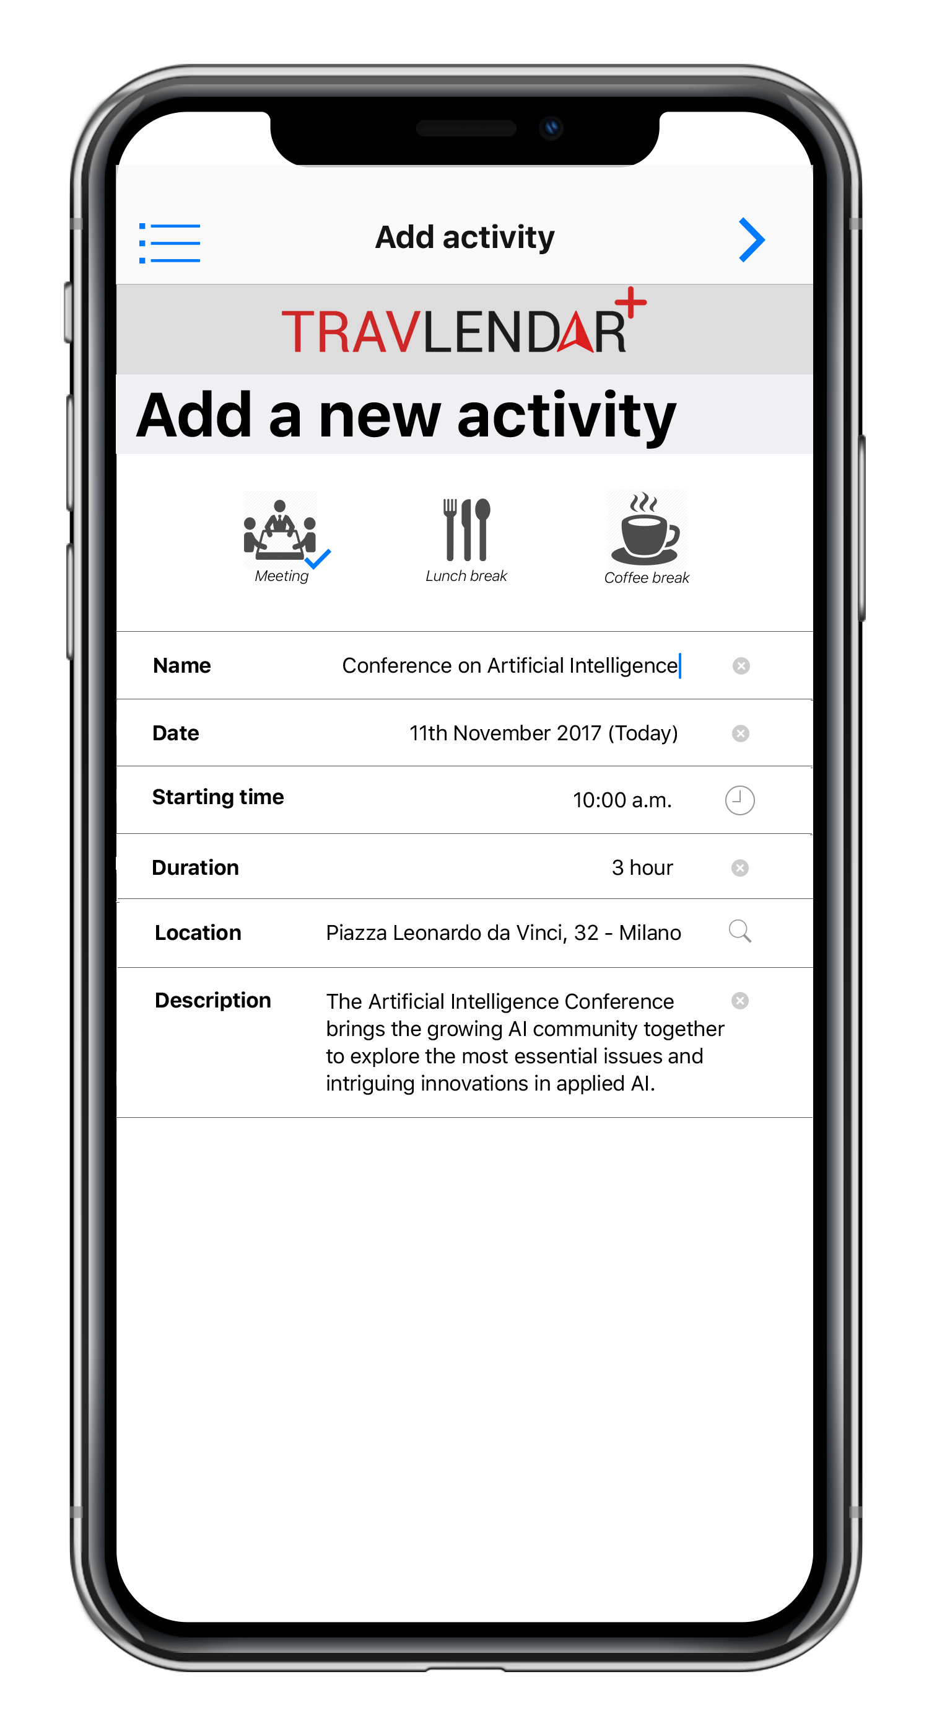
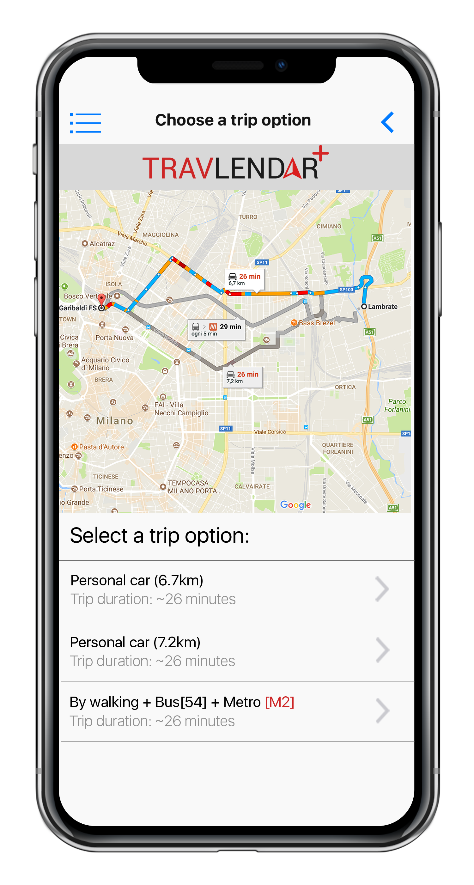
Some Mockups (2)

Slide 6
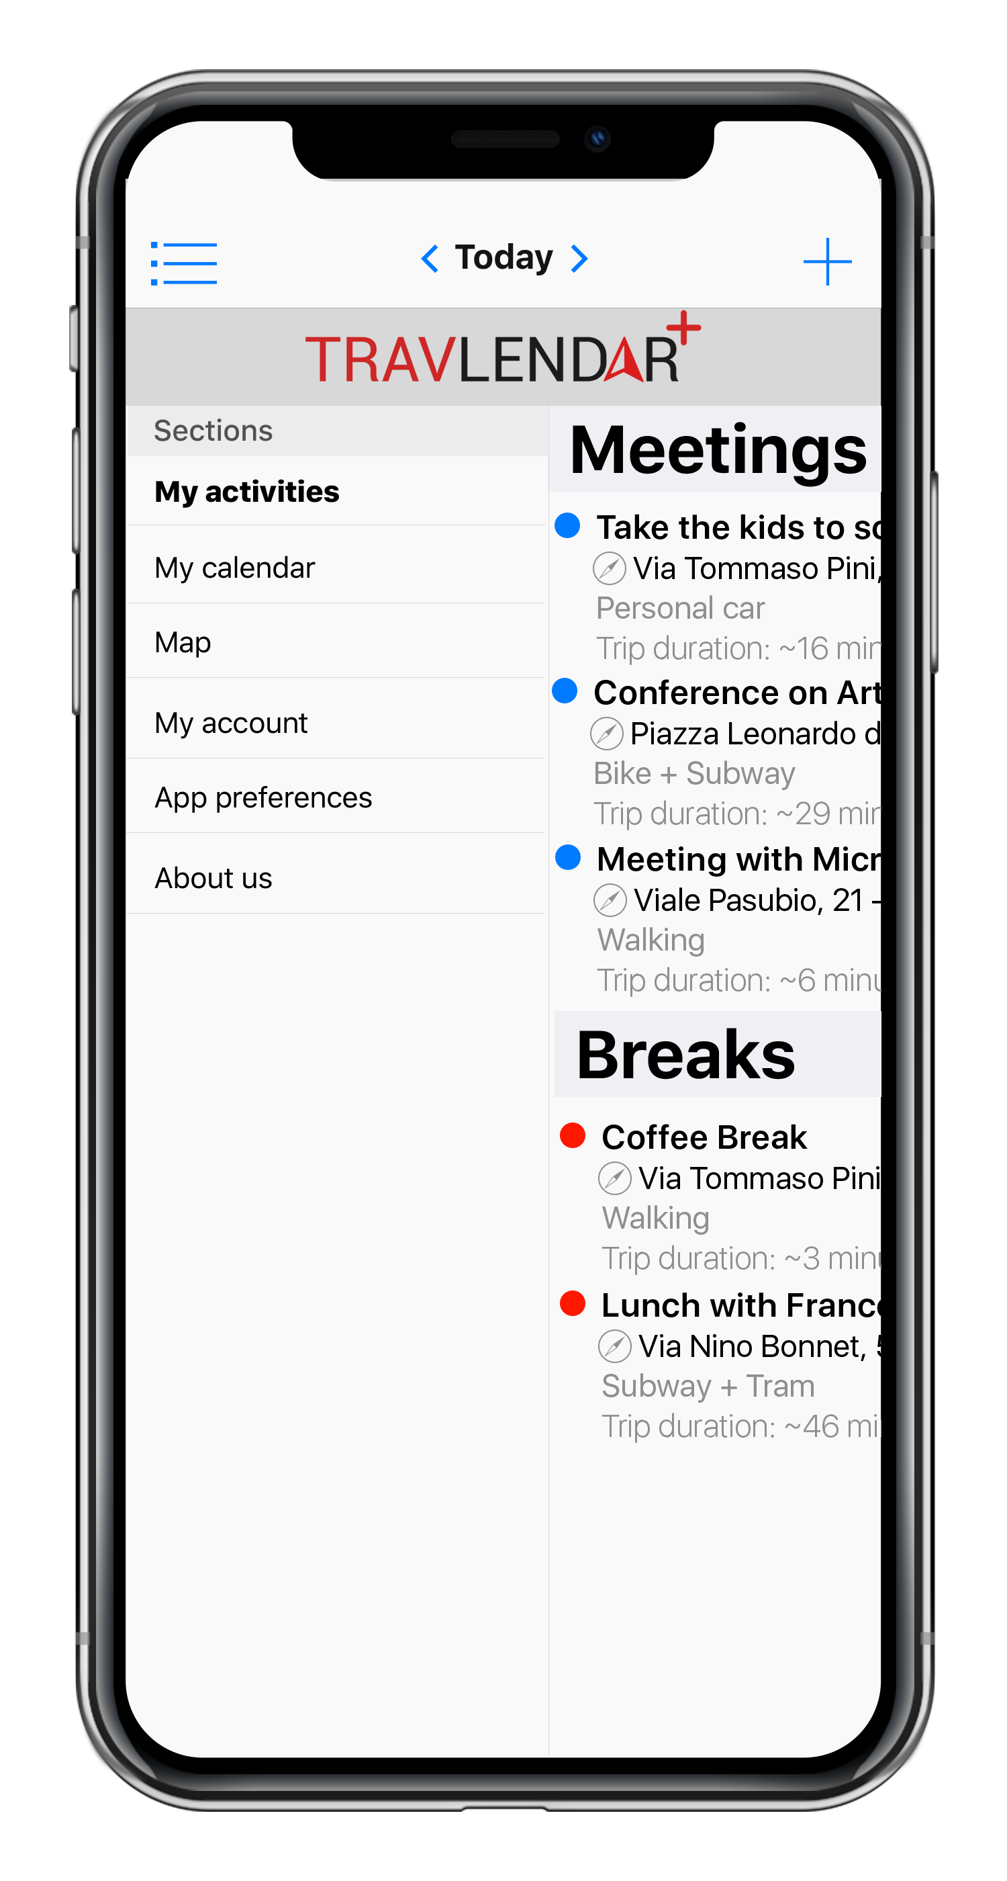
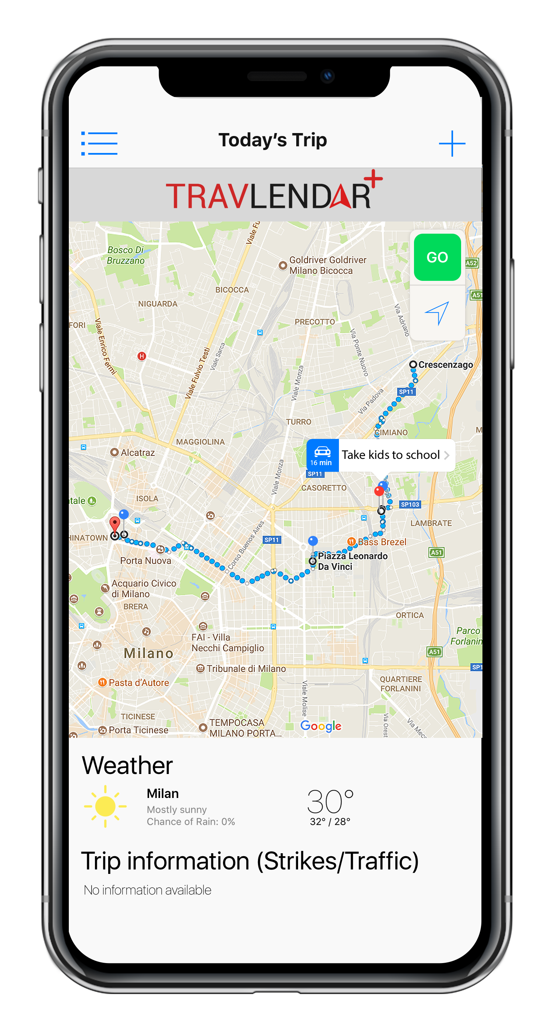
Some Mockups (3)

Slide 7
What are its boundaries? (1)
Dependencies
[DE1] The application depends on external application and websites for some services, such as: the purchase of public transportation's tickets, the use of vehicle sharing systems.
[DE2] The application bases on some other services like Google Maps, weather services and traffic services and uses the received information to guarantee its services.

Slide 8
What are its boundaries? (2)
Constraints
[C1] Travlendar+ requires a smartphone or a tablet with internet connection in order to offer its functionalities.
[C2] Travlendar+ needs a GPS service to find the correct location of the user.

Slide 9
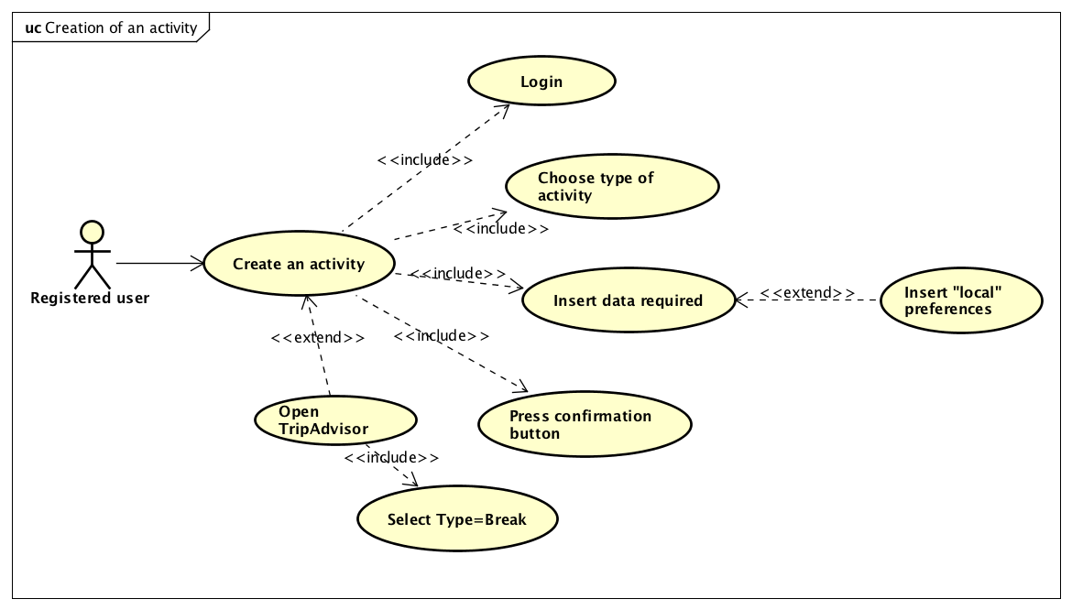
What is a meaningful use case?

Slide 10
What are the most important three to five requirements?
The most important prerequisite is:
”The system should allow only registered users to log in.”
Other important requirements are:
The system should allow registered users to create meetings.
The system should be able to calculate necessary time for each trip option.
The system should allow the user to specify the minimum duration of the break.
The system must keep track of user's preferences.

Slide 11
What are the most important assumptions?
[A1] Accurate registered user's location is known by GPS.
[A2] The user knows the right details about the activities.
[A3] The public transportations are always in time.
[A4] The external third part services (e.g. vehicle sharing systems, google maps, travel means' websites ecc...) work correctly.
[A5] The news about the traffic, the weather and strikes are correct and known in advance.
[A6] Maps are always updated.
[A7] The user attends meetings in existing locations.
[A8] Public transportations have services that allow a user to buy tickets online.

Slide 12
What do you aim to analyse and prove through the Alloy model?
We use Alloy to prove the consistency of our created model.
We want to prove the correctness of our model and to verify the most important properties.

